Slide 1
Syntax Directed Translation

Slide 2
Syntax Directed Translation
Syntax-directed translation (SDT) refers to a method of compiler implementation where the source language translation is completely driven by the parser.
The parsing process and parse trees are used to direct semantic analysis and the translation of the source program.
We can augment grammar with information to control the semantic analysis and translation. Such grammars are called attribute grammars.

Slide 3
Syntax Directed Translation
Associate attributes with each grammar symbol that describes its properties.
An attribute has a name and an associated value.
With each production in a grammar, give semantic rules or actions.
The general approach to syntax-directed translation is to construct a parse tree or syntax tree and compute the values of attributes at the nodes of the tree by visiting them in some order.

Slide 4
Syntax Directed Translation
There are two ways to represent the semantic rules associated with grammar symbols.
Syntax-Directed Definitions (SDD)
Syntax-Directed Translation Schemes (SDT)

Slide 5
Syntax-Directed Definitions
A syntax-directed definition (SDD) is a context-free grammar together with attributes and rules.
Attributes are associated with grammar symbols and rules are associated with productions.
PRODUCTION SEMANTIC RULE
E → E1 + T E.code = E1.code || T.code || ‘+’

Slide 6
Syntax-Directed Definitions
SDDs are highly readable and give high-level specifications for translations.
But they hide many implementation details.
For example, they do not specify order of evaluation of semantic actions.

Slide 7
Syntax-Directed Translation
Syntax-Directed Translation Schemes (SDT) embeds program fragments called semantic actions within production bodies.
SDTs are more efficient than SDDs as they indicate the order of evaluation of semantic actions associated with a production rule.

Slide 8
Inherited Attributes
An INHERITED ATTRIBUTE for a non-terminal B at a parse-tree node N is defined by a semantic rule associated with the production at the parent of N. The production must have B as a symbol in its body.
An inherited attribute at node N is defined only in terms of attribute values at N's parent, N itself, and N's siblings.

Slide 9
Synthesized Attributes
Each of the non-terminals has a single synthesized attribute, called val.
An SDD that involves only synthesized attributes is called S-attributed
Each rule computes an attribute for the non-terminal at the head of a production from attributes taken from the body of the production.

Slide 10
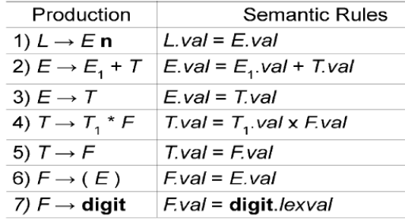

Slide 11
Evaluating an SDD at the Nodes of a Parse Tree
A parse tree, showing the value(s) of its attribute(s) is called an annotated parse tree.
With synthesized attributes, evaluate attributes in bottom-up order.

Slide 12
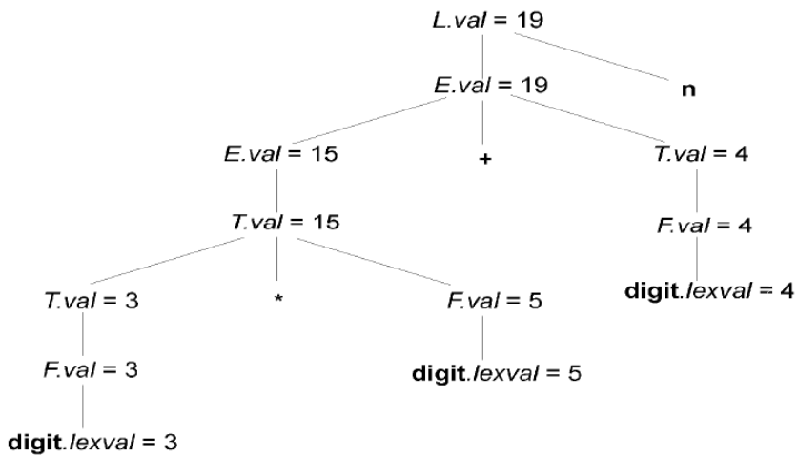
Annotated Parse Tree for 3*5+4n

Slide 13
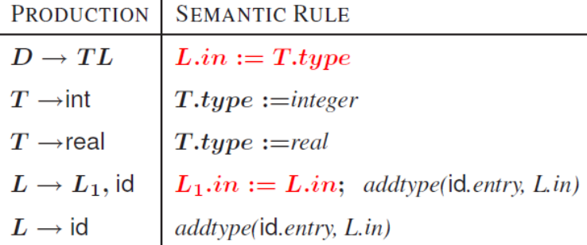
SDD for expression grammar with inherited attributes

Slide 14
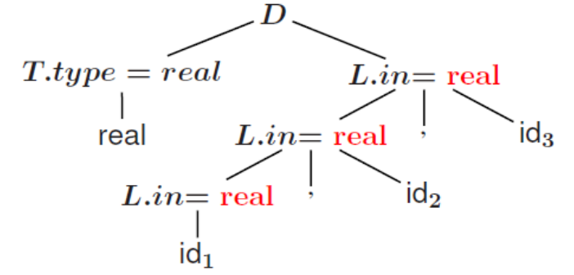
Annotated parse-tree for the input real id1, id2, id3

Slide 15
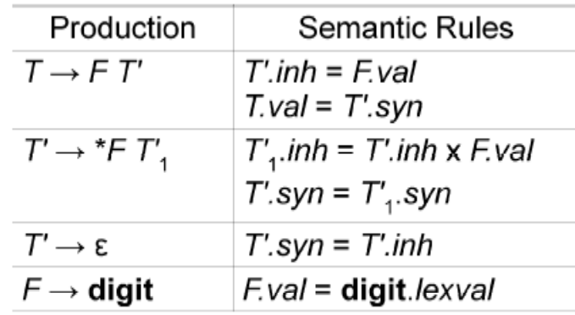
SDD for expression grammar with inherited attributes

Slide 16
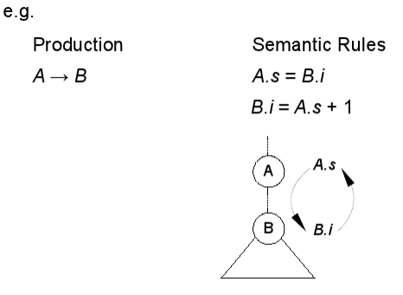
SDD with circular dependencies

Slide 17
Evaluation Orders for SDD's
"Dependency graphs“ tool for determining an evaluation order for the attribute instances in a given parse tree.
Annotated parse tree shows the values of attributes, a dependency graph helps to determine how those values can be computed.

Slide 18
Dependency graphs
Edges express constraints implied by the semantic rules.
Each attribute is associated to a node
If a semantic rule associated with a production p defines the value of synthesized attribute A.b in terms of the value of X.c, then graph has an edge from X.c to A.b
If a semantic rule associated with a production p defines the value of inherited attribute B.c in terms of value of X.a, then graph has an edge from X.a to B.c

Slide 19
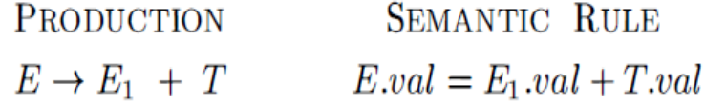
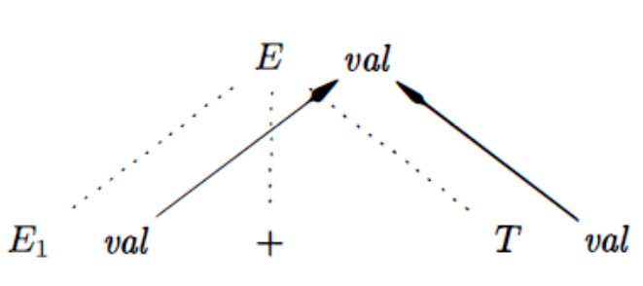

Slide 20
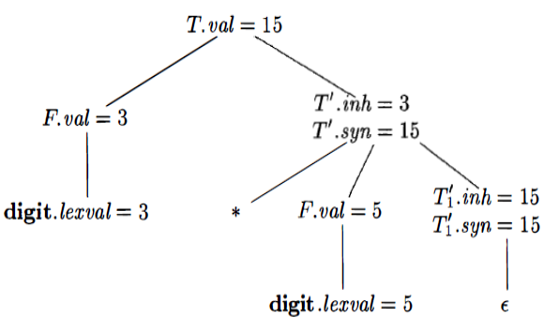

Slide 21
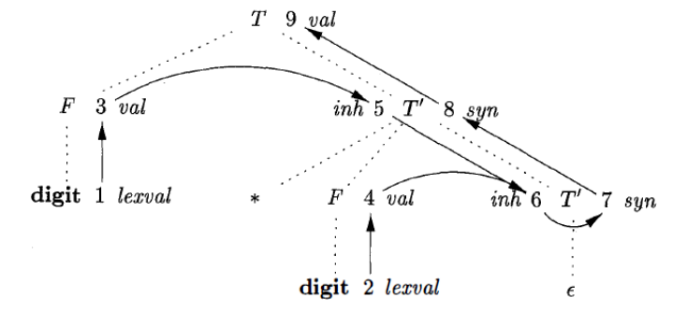

Slide 22
S-Attributed
If every attribute is synthesized.
S-attributed SDD can be evaluated in bottom up order of the nodes of the parse tree.

Slide 23
L-attributed definitions
Synthesized, or
Inherited, but with the rules limited as follows . Suppose that there is a production A -> X_{I} X₂ ... X_{n} , and that there is an inherited attribute X_{i}·a computed by a rule associated with this production. Then the rule may use only:
Inherited attributes associated with the head A.
Either inherited or synthesized attributes associated with the occurrences of symbols X_{l} , X₂ , … ,X_{i-l} located to the left of X_{i}.
Inherited or synthesized attributes associated with this occurrence of X_{i} itself, but only in such a way that there are no cycles in a dependency graph formed by the attributes of this X_{i}.

Slide 24
Semantic Rules with Controlled Side Effects
Permit incidental side effects that do not disturb attribute evaluation.
Impose restriction on allowable evaluation orders, so that the same translation is produced for any allowable order.

Slide 25
Applications of Syntax-Directed Translations
Construction of Syntax Trees
Syntax trees are useful for representing programming language constructs like expressions and statements.
Each node of a syntax tree represents a construct; the children of the node represent the meaningful components of the construct.
e.g. a syntax-tree node representing an expression E1 + E2 has label + and two children representing the sub expressions E1 and E2

Slide 26
Applications of Syntax-Directed Translations
Each node is implemented by objects with suitable number of fields; each object will have an op field that is the label of the node with additional fields as follows:
If the node is a leaf, an additional field holds the lexical value for the leaf . This is created by function Leaf(op, val)
If the node is an interior node, there are as many fields as the node has children in the syntax tree. This is created by function Node(op, c1, 2,...,ck) .

Slide 27
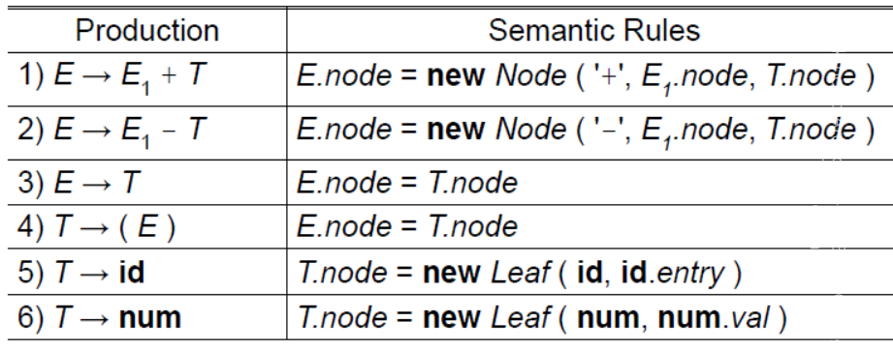

Slide 28
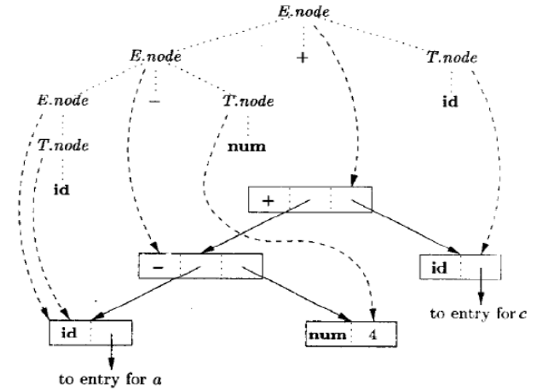

Slide 29
Syntax Directed Translation Schemes
SDT can be implemented by first building a parse tree and then performing the actions in a left-to-right depth-first order.
Postfix Translation Schemes: each semantic action can be placed at the end of production and executed along with the reduction of body to the head of the production.

Slide 30
